Slide 1

ANALYSIS OF FACTORS CONTRIBUTING TO THE CRIME - RATE IN BUFFALO
Amar A R Dharwadkar
Rohit Tananki
Sahithi Dodda
Shrunga Nagaraj
https://youtu.be/d76PkA2Q5N0

Slide 2
Introduction
Buffalo has one of the highest crime rates in America compared to communities of all sizes
Chance of becoming a victim here is one in 26
Within New York, more than 98% of the communities have a lower crime rate than Buffalo
In our study, we used four models to investigate the relationship between several predicting factors and crime occurrence probability with regards to the epicenter

Slide 3
OBJECTIVE
Worked on the Buffalo crime data set to
To find factors affecting crime and predict the crime rate in various districts of Buffalo
Our analysis includes visualizations on the data, used Heatmaps and Correlation Matrices to determine the accuracy rate and identify crime trends in Buffalo
Used Logistic Regression, KNN, Decision Tree and Random Tree models to try and accurately predict crime
We intend to use these as we are trying to answer a True or False Question, will crime occur if certain factors are present?

Slide 4
DATA SOURCE
Describes types of crime occurring like Theft, Assault, incident datetime etc
District/Neighborhood/Latitude and Longitude and when the crime occurred
The dataset is obtained from https://data.buffalony.gov/
Total number of observations in the dataset: 281k
Total number of variables(columns) in the dataset: 29
Each row is a crime incident and the variables are as follows:
'Case_Number', 'Incident_Datetime', 'Incident_Type_Primary', 'Incident_Description’, 'Parent_Incident_Type', 'Hour_of_Day', 'Day_of_Week', 'Address', 'City', 'State', 'Location’, 'Latitude’, 'Longitude', 'Created_At', 'updated_at', '2010_Census_Tract_’, '2010_Census_Block_Group’, '2010_Census_Block', 'Census_Tract', 'Census_Block’, 'Census_Block_Group', 'Neighborhood’, 'Police_District', 'Council_District’, 'TRACTCE20’, 'GEOID20_tract', 'GEOID20_blockgroup’, 'GEOID20_block'

Slide 5
MODELS
Logistic Regression
K-Nearest Neighbor(KNN)
Decision Trees
Random forest
Ensemble Methods
Bagging
Boosting

Slide 6
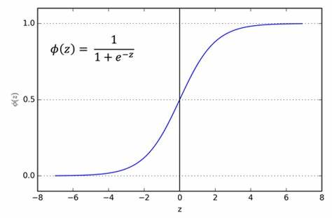
Logistic Regression
Logistic Regression is a classification algorithm, which estimates the probability of an event occurring, based on a given dataset of independent variables. Since the outcome is a probability, the dependent variable is bounded between 0 and 1.
Transforms its output using Logistic Sigmoid Function.

Slide 7
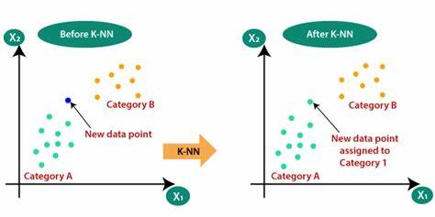
K-Nearest Neighbor(KNN)
KNN is a non-parametric, supervised learning classifier, which uses proximity to make classifications/predictions about the grouping of an individual data point.
It can be used for either regression or classification problems, it is typically used as a classification algorithm, working off the assumption that similar points can be found near one another.

Slide 8
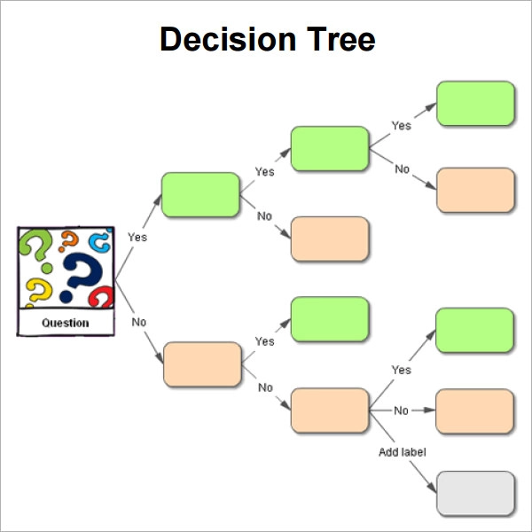
Decision TreeS
It is a non-parametric supervised learning algorithm, which is utilized for both classification & regression tasks. It has a hierarchical, tree structure, which consists of a root node, branches, internal nodes, and leaf nodes.
Decision tree employs a divide-and-conquer strategy by conducting a greedy search to identify the optimal split points within a tree. This process of splitting is then repeated in a top-down, recursive manner until all, or most records have been classified under specific class labels.

Slide 9
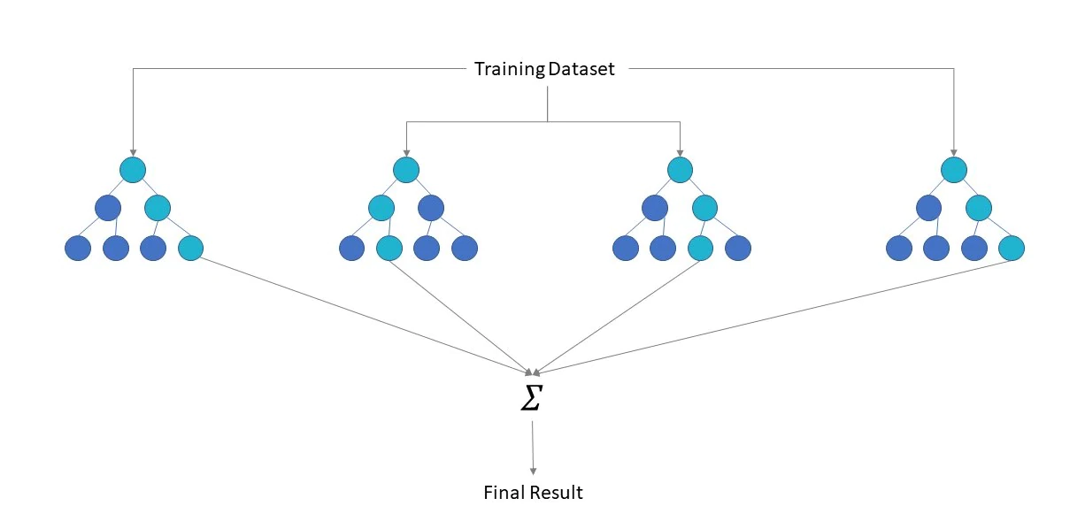
Random forest
It is made up of a collection of decision trees, and each tree in the ensemble is comprised of a data sample drawn from a training set with replacement, called the bootstrap sample. The random forest algorithm utilizes both bagging and feature randomness to create an uncorrelated forest of decision trees. It is used for both classification and regression problems.
Feature randomness generates a random subset of features, which ensures low correlation among decision trees. This is a key difference between decision trees and random forests. While decision trees consider all the possible feature splits, random forests only select a subset of those features.

Slide 10
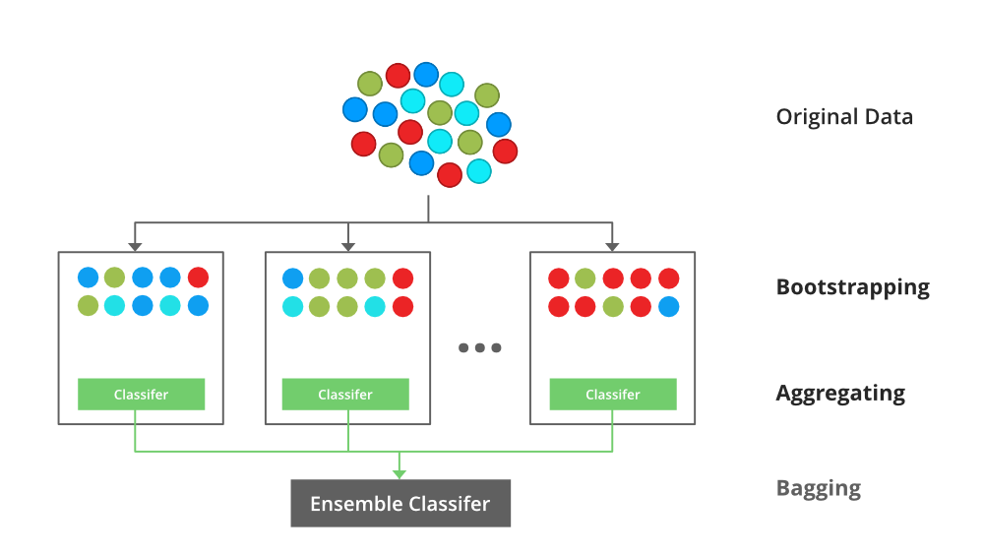
Bagging
Bootstrap Aggregating, also known as bagging, is an ensemble meta-algorithm designed to improve the stability and accuracy of algorithms used in statistical classification and regression. It decreases the variance and helps to avoid overfitting.
It is usually applied to decision tree methods. Bagging is a special case of the model averaging approach. The Random Forest model uses Bagging, where decision tree models with higher variance are present. It makes random feature selections to grow trees.

Slide 11
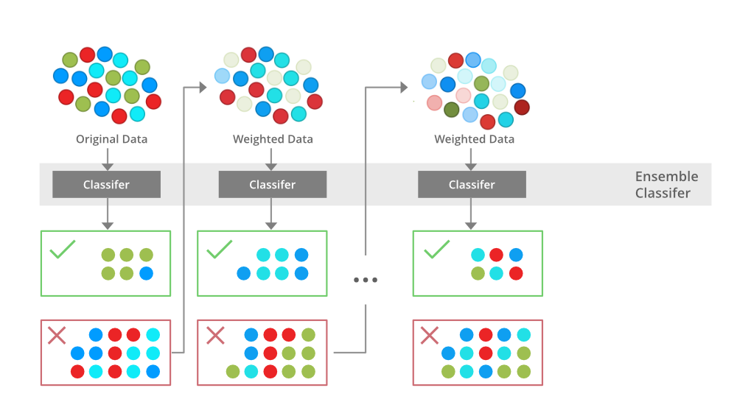
Boosting
Boosting is an ensemble modeling technique that attempts to build a strong classifier from the number of weak classifiers. Firstly, a model is built from the training data.
Then the second model is built which tries to correct the errors present in the first model. This procedure is continued, and models are added until either the complete training data set is predicted correctly, or the maximum number of models are added.

Slide 12
Conclusion:
The analysis performed can be used to understand the locations at which the crime rate is high, what types of crimes are occurring the most and at what times these crimes occur the most. With this data people can avoid visiting these places during the midnight or afternoons. This would also help the police department tighten security at the places during these timings as well. People can also investigate the safety factors before renting or buying a home .

Slide 13
Acknowledgment
We would like to express our deep gratitude to Professor Rachael Hageman Blair for her patient guidance, enthusiastic encouragement and useful critiques of this Subject. we would also like to thank her for great learning and assistance in keeping our progress on schedule.

